Slide 1
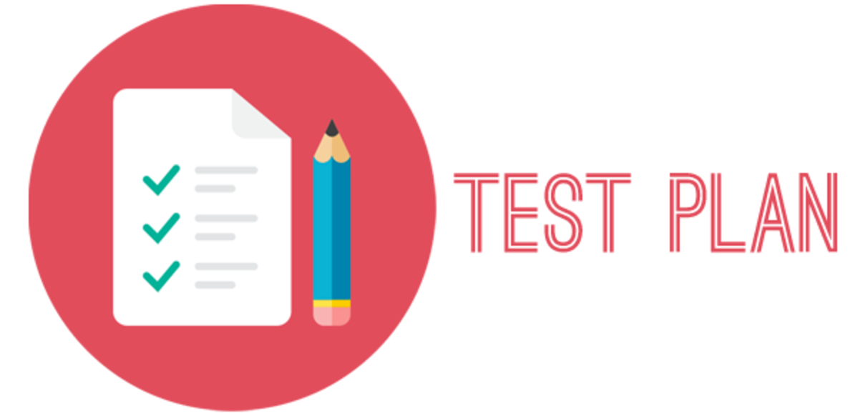
Test plan is the high level document, which explains the roadmap of the project, which is describing the scope, approach, resources and schedule of intended test activities.
Test Plan is a dynamic document. Test Plan is more or less like a blue print of how the testing activity is going to take place in a project.
A document which will give you 4 answers:
Who ? - who will test it ?
When ? - when to start and finish testing?
How ? - how to test?
What? - what needs to be tested? - what is the scope? - what is timeline?
Who will make it? - Test Manager or QA (sometimes)

Slide 2
elements of test plan
Test Plan ID:
Scope and Objective: what can be tested and what can’t ?
Test Items: How many functionalities/features in total we gonna test ? e.g.. 10
Features to be tested: 6
Features not to be tested: 4
Test Approach: Manual, Automation, Toolset
Test Schedule: Task Estimation
Entry Criteria: When to start testing?
Exit Criteria: When to stop testing?
Roles and Responsibilities: who will do what ?
Staff and Training: If any training is required ? plan ahead
Risk Assumptions and Management: What are the risk associated and how to resolve them. Risk identification—> Risk impact analysis —>Risk Mitigation

Slide 3


Slide 4
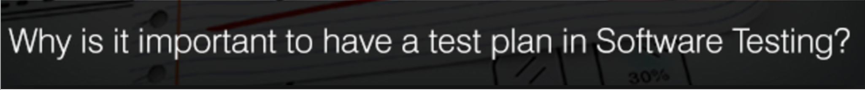
Planning makes a task execution in a systematic manner: No matter which situation we are dealing with, we can make it simpler by proper planning (as it gives an ideal path for the execution process).
Test plan for finding a suitable way to execute the testing process: Test plan give an inside look of the project and hence helping in developing a better testing approach.
We can avoid loopholes: With test plan we can presume and assume most of the upcoming uncertain risks/issues of the application.
Efficient testing can be achieved with test plan: by eliminating unnecessary tasks, processes from the application
Effort will be minimised and productivity will be maximised: by avoiding unnecessary iterative processes which in turn reduce the effort and time

Slide 5
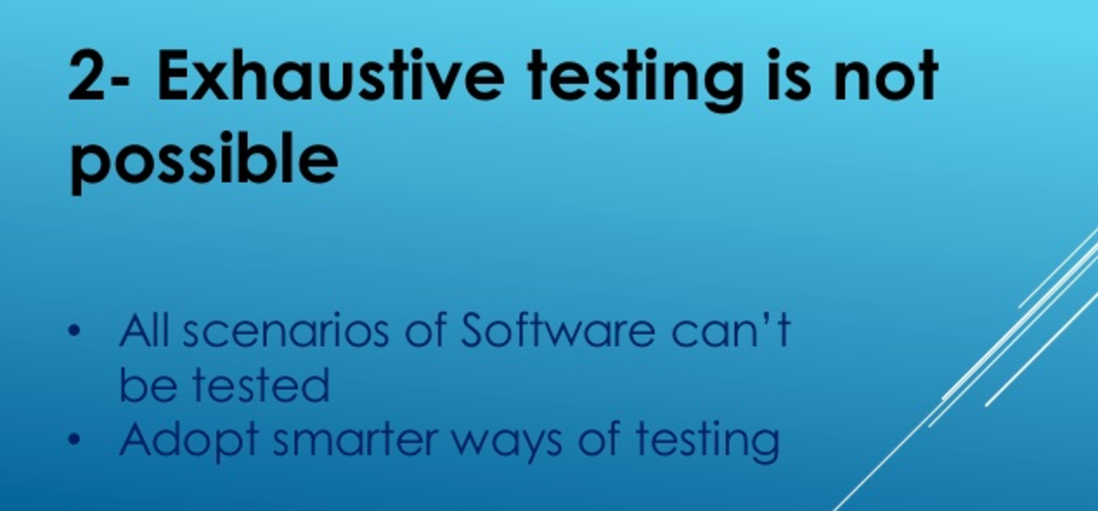

Testing techniques: why we need them ?
It reduces the time required for performing testing of a software due to less number of test cases.
BVA
ECP
Error guessing

Slide 6
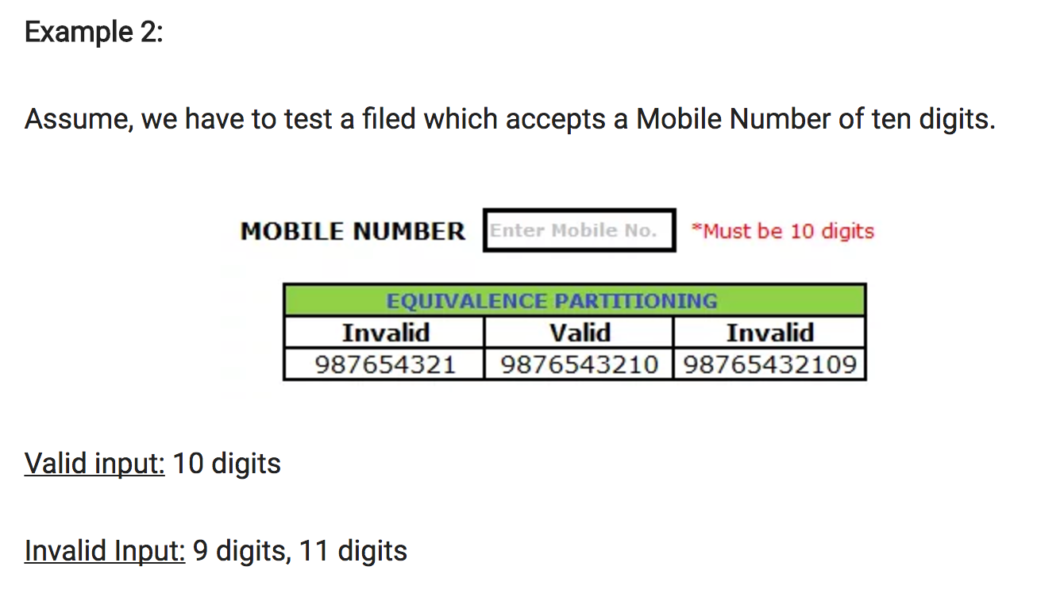
equivalence class partitioning (ECP)
Also known as Equivalence Partitioning.
In equivalence partitioning, inputs to the software or system are divided into groups that are expected to exhibit similar behaviour. Hence selecting one input from each group to design the test cases.
The key goal is to complete the test coverage and to lessen duplication.

Slide 7
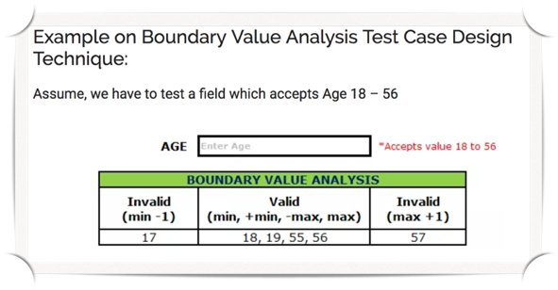

Boundary Value analysis (BVA)
A test case design technique leads to selection of a test cases that exercising bounding the values.
Boundary value analysis (BVA) is based on testing the boundary values of valid and invalid partitions. The Behaviour at the edge of each equivalence partition is more likely to be incorrect than the behaviour within the partition, so boundaries are an area where testing is likely to yield defects.
According to BVA, the 5 values needs to be tested:
Minimum (min)
Above minimum (min + 1)
Below minimum (min - 1)
Normal
Maximum (max)
Below maximum (max - 1)
Above maximum (max + 1)

Slide 8


error guessing
Process of making an education guess as to other types of an area to be tested.
Tester guesses from his/her experience on the error prone area and concentrate more around that area.
Can detect some of the defects which is failed by the systematic testing
Consider:
Past experience
Intuition
Past failures (error prone areas)
“What craziest thing I can do ?”
Brain storming
Exploratory Testing

Slide 9
Software development models
The software development models are the various processes or methodologies that are being selected for the development of the project depending on the project’s aims and goals.
There are various Software development models or methodologies.
Waterfall Model
V-Model
Iterative Model
Agile Methodology: Agile scrum, Agile BDD
Kanban
Spiral Model
Extreme Programming (XP)
Dynamic System Development Method (DSDM).

Slide 10
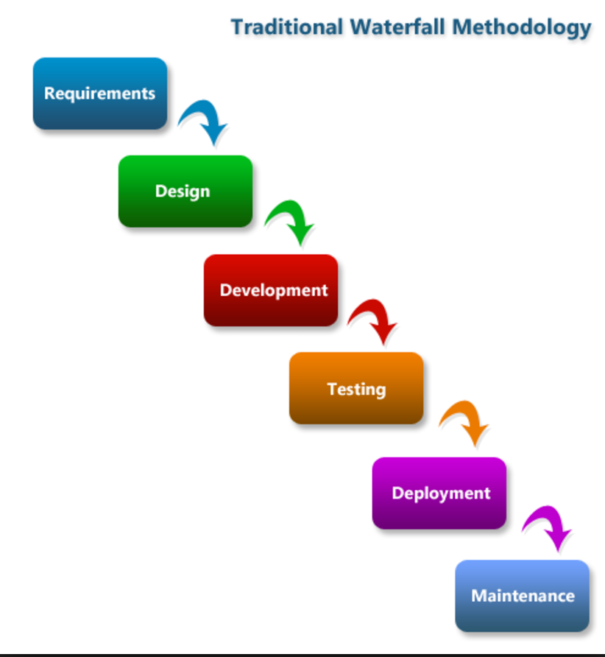
waterfall model
Was the first Process Model to be introduced.
It is also referred to as a linear-sequential life cycle model.
Is an easy methodology to understand and use
There are no overlapping stages. Each phase must be completed fully before the next phase can begin.
It is most effective in small projects and there are no uncertain requirements.
At the end of each phase, a review takes place to determine if the project is on the right path and whether or not to continue or discard the project.
Very less customer interaction is involved during the development of the product. Once the product is ready then only it can be demoed to the end users.
In Waterfall model software testing starts only after the development is complete.

Slide 11
Disadvantages of Waterfall Model:-
1. Change requests are not welcomed especially when testing starts.
2. No working software is produced until late during the life cycle.
3. High amounts of risk and uncertainty.
4. Not a good model for complex and object-oriented (long and ongoing) projects.
5. Not suitable for the projects where requirements are constantly changing.
When to use the waterfall model:-
1. This model is used only when the requirements are very well known, clear and fixed.
2. Product definition is stable.
3. Technology is understood.
4. There are no ambiguous requirements
5. Ample resources with required expertise are available freely
6. The project is short.

Slide 12
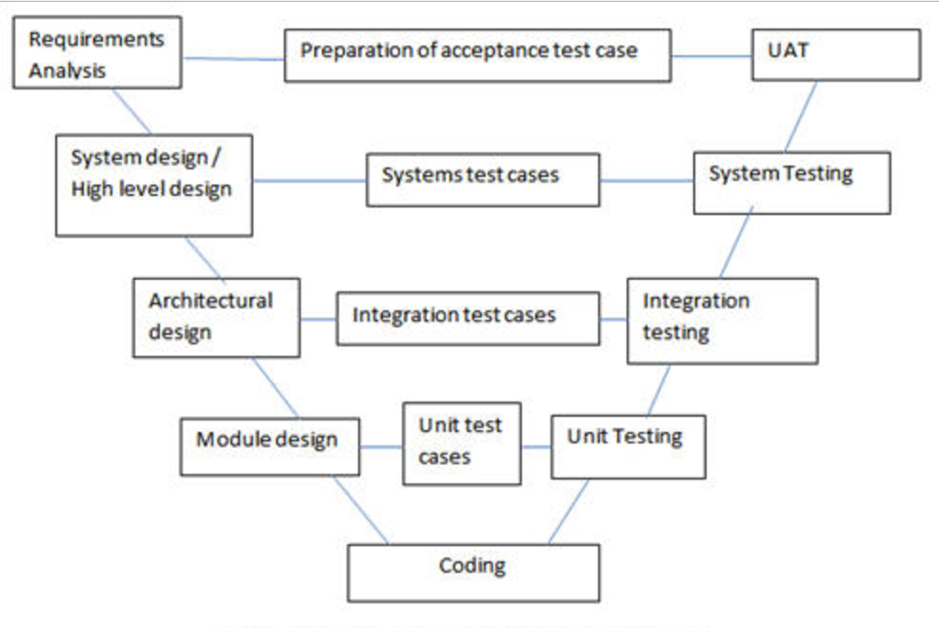
V-model
V- stands for Verification and Validation.
Why ? It was very challenging and costly to fix the defects found in later stage of development cycle in case of waterfall model. To overcome this problem, a new development model was introduced called the “V Model”.
V-model is an extension of waterfall model.
Introduction of V model has actually proved the implementation of testing right from the requirement phase. .
In V model, the development and QA activities are done simultaneously.
The verification and validation activities go hand in hand.

Slide 13
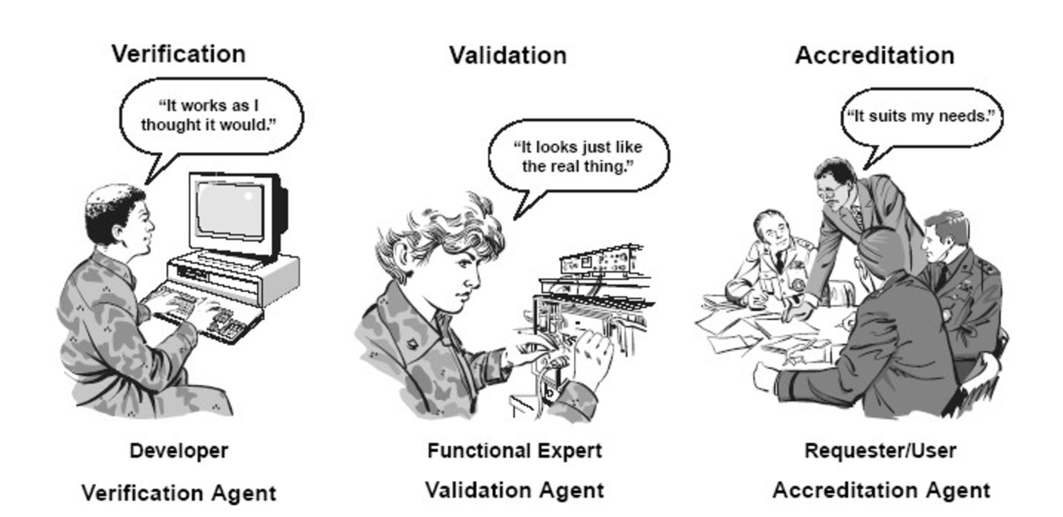

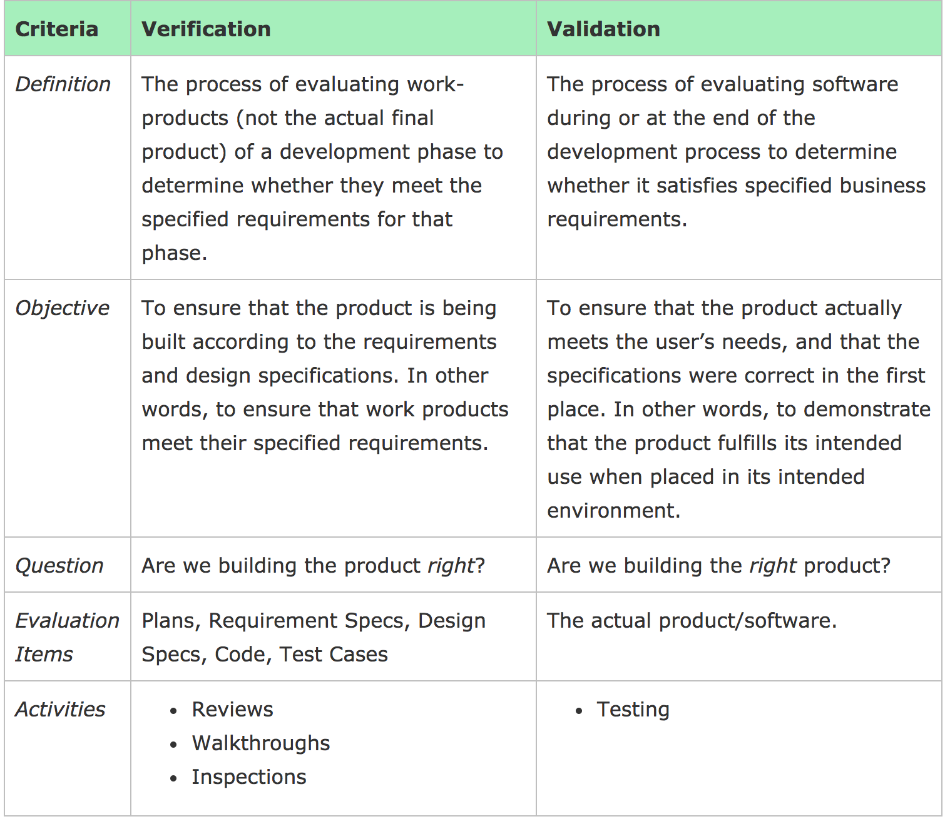
Verification vs validation
Verification: Verification is a static analysis technique. In this technique testing is done without executing the code. Examples include – Reviews, Inspection and walkthrough.
Validation: Validation is a dynamic analysis technique where testing is done by executing the code. Examples include functional and non-functional testing techniques.

Slide 14
Advantages of V-Model:-
Development and progress is very organised and systematic
Works well for smaller to medium sized projects.
Testing starts from beginning so ambiguities are identified from the beginning.
Easy to manage as each phase has well defined objectives and goals.
Disadvantages of V-Model:-
Not suitable for bigger and complex projects
Not suitable if the requirements are not consistent.
No working software is produced in the intermediate stage.
No provision for doing risk analysis so uncertainty and risks are there.
When to use the V-Model:-
Requirement is well defined and not ambiguous
Project is short to medium in size.
Technology and tools used are not dynamic.

Slide 15
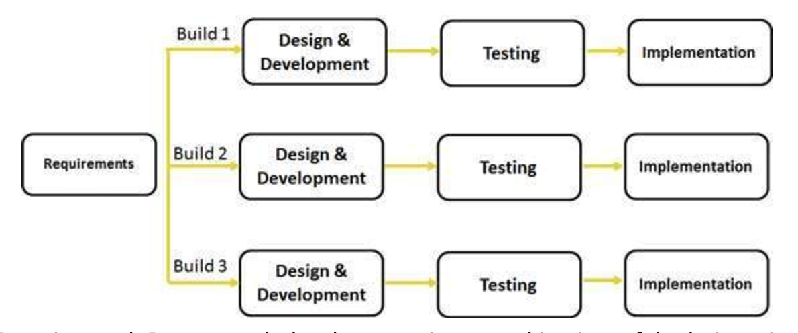
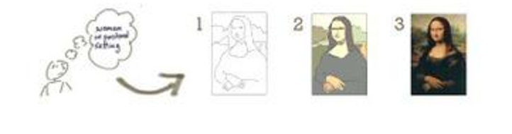
iterative model
Iteration : the repetition of a process
Full specification of requirements not needed. Instead, development begins by specifying and implementing just part of the software.
Iterative process starts with a simple implementation of a small set of the software requirements and iteratively enhances the evolving versions until the complete system is implemented and ready to be deployed

Slide 16
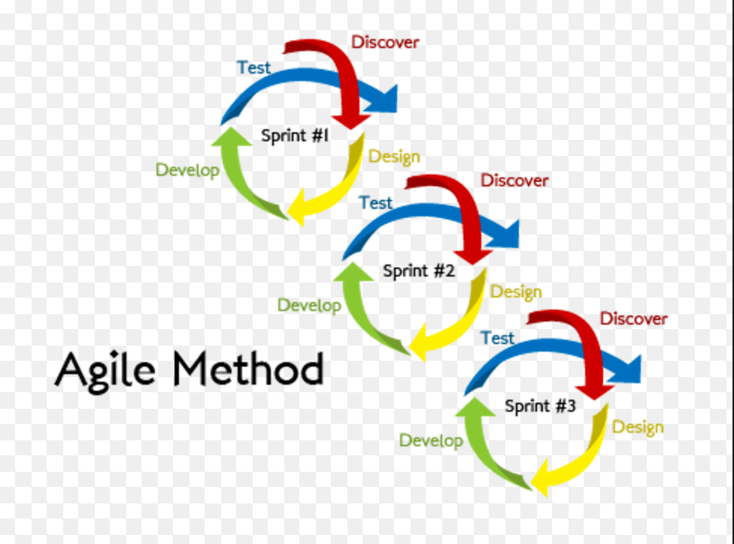
agile methodology
What is agile ? able to move quickly and easily.
Incremental, rapid software development cycles.
Results in small incremental (continuous iteration) (sprint) releases with each release building on previous functionality.
Each release is thoroughly tested to ensure software quality is maintained.
Both development and testing activities are concurrent.
The agile software development emphasises on four core values.
Individual and team interactions over processes and tools
Working software over comprehensive documentation
Customer collaboration over contract negotiation
Responding to change over following a plan
Agile software development describes a set of principles for software development under which requirements and solutions evolve through the collaborative effort of self-organising cross-functional teams. It advocates adaptive planning, evolutionary development, early delivery, and continuous improvement, and it encourages rapid and flexible response to change.

Slide 17
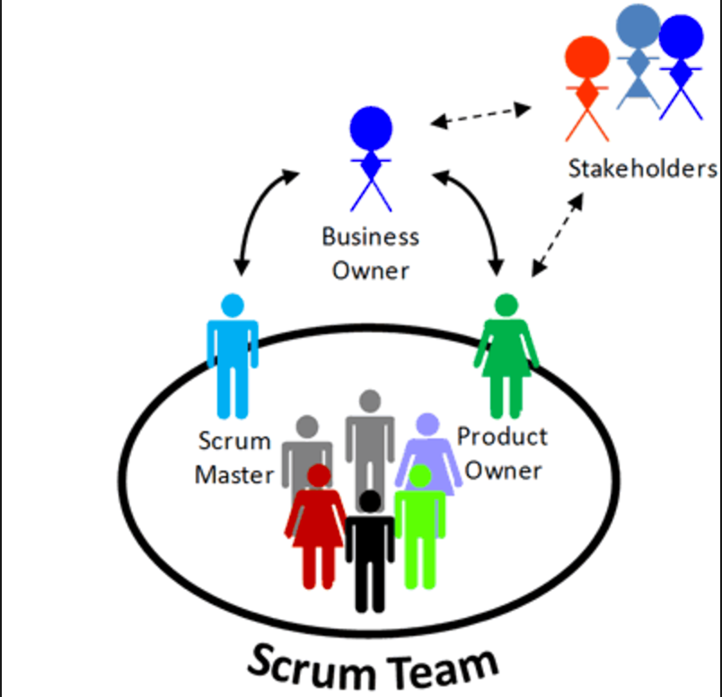
Agile Team
An agile team is a cross-functional group of people that have everything, and everyone, necessary to produce a working, tested increment of product.
The Product Owner:
Champion for their product.
Focused on understanding business and market requirements, then prioritising the work to be done by the engineering team accordingly.
The Scrum Master:
Champion for scrum.
Coach the team, PO, and the business on the scrum process and look for ways to fine-tune their practice of it.
The Scrum Team:
Scrum Developer
Scrum Tester
The Business Analyst:
Understanding business change needs
Capturing, analysing and documenting requirements
Communication and delivery of requirements with relevant stakeholders.

Slide 18
Agile meetings
Sprint planning: A team planning meeting that determines what to complete in the coming sprint. (beginning of sprint)
Daily stand-up: Also known as a daily scrum, a 15-minute mini-meeting for the software team to sync.
We need to answer two questions. (daily)
What we have done yesterday? and What we gonna do today?
Backlog Grooming/Backlog Refinement: Team review items on the backlog to ensure the backlog contains the appropriate items, that they are prioritised, and that the items at the top of the backlog are ready for delivery.
Sprint demo/Showcase: A sharing meeting where the team shows what they've shipped in that sprint.
Demo to the client (At the end of sprint)
Sprint retrospective: A review of what did and didn't go well with actions to make the next sprint better.

Slide 19
agile scrum
Scrum is a subset of Agile. It is a lightweight process framework for agile development, and the most widely-used one.
A product owner creates a prioritised wish list called a product backlog.
During sprint planning, the team pulls a small chunk from the top of that wish list, a sprint backlog, and decides how to implement those pieces.
The team has a certain amount of time — a sprint (usually two to four weeks) — to complete its work, but it meets each day to assess its progress (daily Standing).
Along the way, the ScrumMaster keeps the team focused on its goal.
At the end of the sprint, the work should be potentially shippable: ready to hand to a customer, put on a store shelf, or show to a stakeholder (Showcase).
The sprint ends with a sprint review and retrospective.
As the next sprint begins, the team chooses another chunk of the product backlog and begins working again.

Slide 20
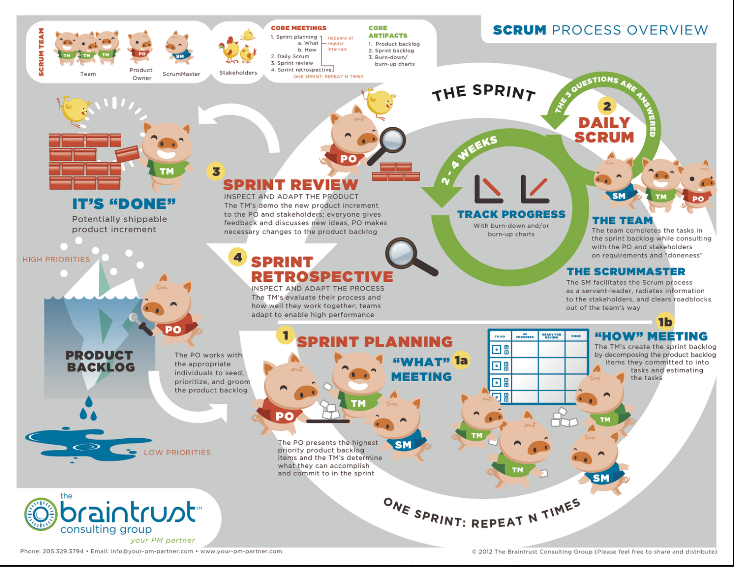

Slide 21
Advantages OF agile model
Customer satisfaction by rapid, continuous delivery of useful software.
People and interactions are emphasised rather than process and tools. Customers, developers and testers constantly interact with each other.
Working software is delivered frequently (weeks rather than months).
Face-to-face conversation is the best form of communication.
Close, daily cooperation between business people and developers.
Continuous attention to technical excellence and good design.
Regular adaptation to changing circumstances.
Even late changes in requirements are welcomed

Slide 22
disadvantages of agile model
Planning can be less concrete: It can sometimes be hard to pin down a solid delivery date. reprioritising tasks and additional sprints may be added at any time in the project, adding to the overall timeline.
Team must be knowledgeable: Agile teams are usually small, so team members must be highly skilled in a variety of areas. They also must understand and feel comfortable with the chosen Agile methodology.
Documentation can be neglected: The Agile Manifesto prefers working software over comprehensive documentation. Agile teams should find the right balance between documentation and discussion.
Final product can be very different: The initial Agile project might not have a definitive plan, so the final product can look much different than what was initially intended. Because Agile is so flexible, new iterations may be added based on evolving customer feedback, which can lead to a very different final deliverable.
Requirements can be mis understood by developers and testers as well.

Slide 23
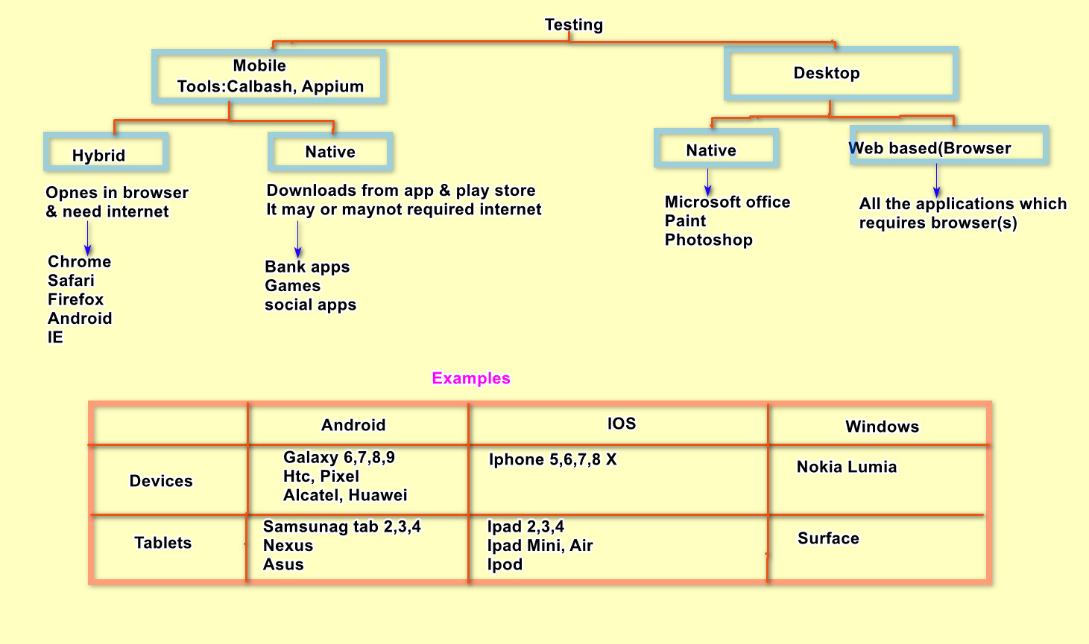
Mobile testing Basic Test cases scenario

